Slide 1
The Enhanced Entity-Relationship (EER) Model
Enhanced ER (EER) model
Created to design more accurate database
schema's
Reflect the data properties and constraints
more precisely
Most suitable for complex application than
traditional applications

Slide 2
Subclasses, Superclasses, and Inheritance
EER model includes all modeling concepts of the ER model
In addition, EER includes:
Subclasses and Superclasses
Specialization and Generalization
Category and union type
Attribute and relationship inheritance

Slide 3
Subclasses, Superclasses, and Inheritance (cont’d.)
Super class
The class which is having its sub grouping ,called as super class
For example :Employee super class is having sub grouping as Technician , Secretary and Developer

Slide 4
Subclasses, Superclasses, and Inheritance (cont’d.)
Subtype or subclass of an entity type
The class which is sub grouping of other class ,called as subclass
A subclass is more specific version of its super class

Slide 5
Subclasses, Superclasses, and Inheritance (cont’d.)
The relationship between a superclass and any one of its subclasses is known as
Superclass/subclass (encircled d)
Supertype/subtype
Class/subclass relationship
Type inheritance
Subclass entity inherits all attributes and relationships of superclass

Slide 6
Subclasses and Superclasses (1)
An entity type may have additional meaningful subgroupings of its entities
Example: EMPLOYEE may be further grouped into:
SECRETARY, ENGINEER, TECHNICIAN, …
Based on the EMPLOYEE’s Job
MANAGER
EMPLOYEEs who are managers
SALARIED_EMPLOYEE, HOURLY_EMPLOYEE
Based on the EMPLOYEE’s method of pay

Slide 7
Subclasses and Superclasses (2)
EER diagrams extend ER diagrams to represent these additional subgroupings, called subclasses or subtypes

Slide 8
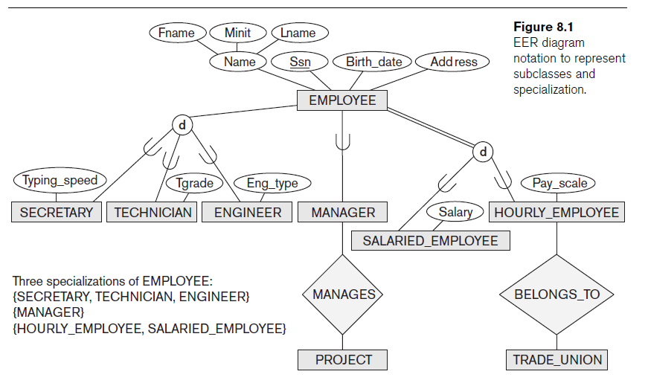

Slide 9
Subclasses and Superclasses (2)
Each of these subgroupings is a subset of EMPLOYEE entities
Each is called a subclass of EMPLOYEE
EMPLOYEE is the superclass for each of these subclasses
These are called superclass/subclass relationships:
EMPLOYEE/SECRETARY
EMPLOYEE/TECHNICIAN
EMPLOYEE/MANAGER
…

Slide 10
Examples:
A salaried employee who is also an engineer belongs to the two subclasses:
ENGINEER, and
SALARIED_EMPLOYEE
A salaried employee who is also an engineering manager belongs to the three subclasses:
MANAGER,
ENGINEER, and
SALARIED_EMPLOYEE
It is not necessary that every entity in a superclass be a member of some subclass

Slide 11
Subclasses and Superclasses (3)
These are also called IS-A relationships
SECRETARY IS-A EMPLOYEE, TECHNICIAN IS-A EMPLOYEE, ….
An entity that is member of a subclass represents the same real-world entity as some member of the superclass:
The subclass member is the same entity in a distinct specific role
An entity cannot exist in the database merely by being a member of a subclass; it must also be a member of the superclass
A member of the superclass can be optionally included as a member of any number of its subclasses

Slide 12
Examples:
A salaried employee who is also an engineer belongs to the two subclasses:
ENGINEER, and
SALARIED_EMPLOYEE
A salaried employee who is also an engineering manager belongs to the three subclasses:
MANAGER,
ENGINEER, and
SALARIED_EMPLOYEE
It is not necessary that every entity in a superclass be a member of some subclass

Slide 13
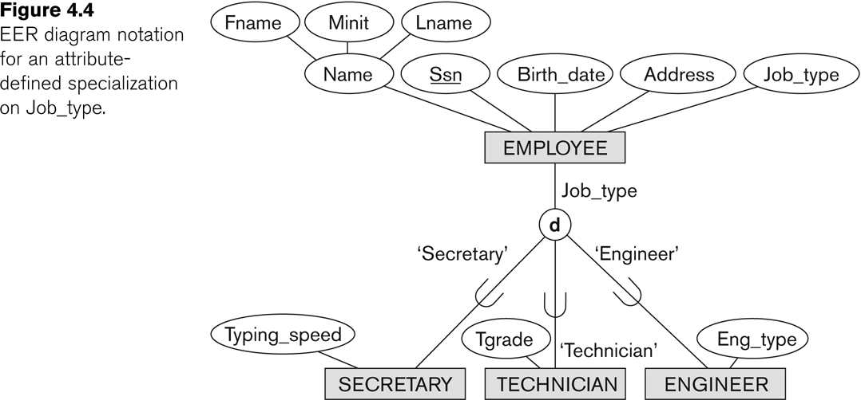
Representing Specialization in EER Diagrams

Slide 14
Attribute Inheritance in Superclass / Subclass Relationships
An entity that is member of a subclass inherits all attributes
of the entity as a member of the superclass.
All relationships of the entity as a member of the superclass
Example: SECRETARY (as well as TECHNICIAN and ENGINEER) inherit the attributes Name, SSN, …, from EMPLOYEE
Every SECRETARY entity will have values for the inherited attributes

Slide 15
Specialization (1)
Specialization is the process of defining a set of
subclasses of a superclass
The set of subclasses is based upon some
distinguishing characteristics of the entities in the
superclass
Example: {SECRETARY, ENGINEER, TECHNICIAN} is a
specialization of EMPLOYEE based upon job type.
May have several specializations of the same
superclass

Slide 16
Specialization (2)
Another example of specialization of EMPLOYEE based on
method of pay is
{SALARIED_EMPLOYEE,HOURLY_EMPLOYEE}.
Superclass/subclass relationships and specialization can be
diagrammatically represented in EER diagrams
Attributes of a subclass are called specific or local attributes.
For example, the attribute Typing Speed of SECRETARY
The subclass can also participate in specific relationship
types.
For example, a relationship BELONGS_TO of
HOURLY_EMPLOYEE

Slide 17
Specialization and Generalization
Specialization
Process of defining a set of subclasses of an entity
type.
Defined on the basis of some distinguishing
characteristic of the entities in the superclass
Subclass can define:
Specific attributes
Specific relationship types

Slide 18
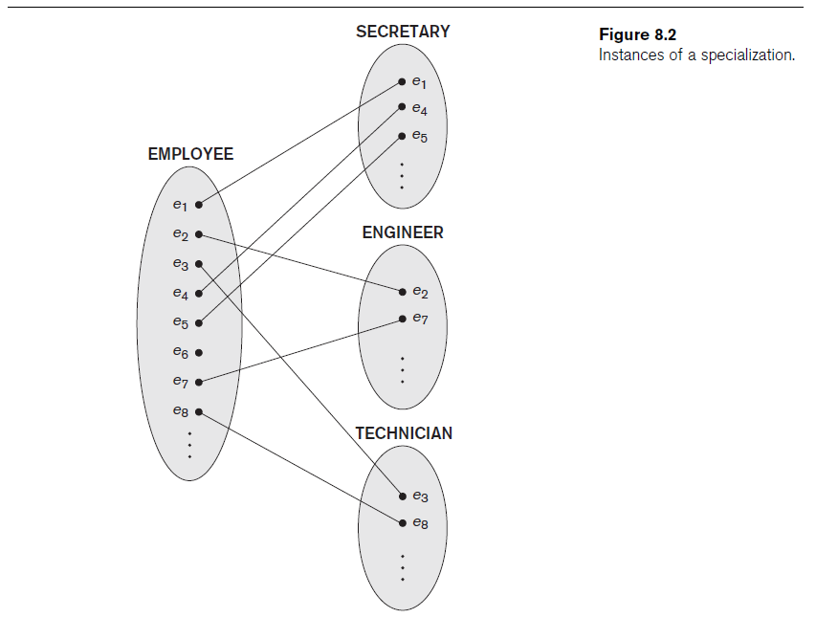

Slide 19
Specialization and Generalization (cont’d.)
Certain attributes may apply to some but not all entities of the superclass
Some relationship types may be participated in
only by members of the subclass

Slide 20
Generalization
Generalization is the reverse of the specialization process.
Several classes with common features are generalized into a superclass.
original classes become its subclasses
Example:
CAR, TRUCK generalized into VEHICLE;
both CAR, TRUCK become subclasses of the superclass VEHICLE.
We can view {CAR, TRUCK} as a specialization of VEHICLE
Alternatively, we can view VEHICLE as a generalization of CAR and TRUCK

Slide 21
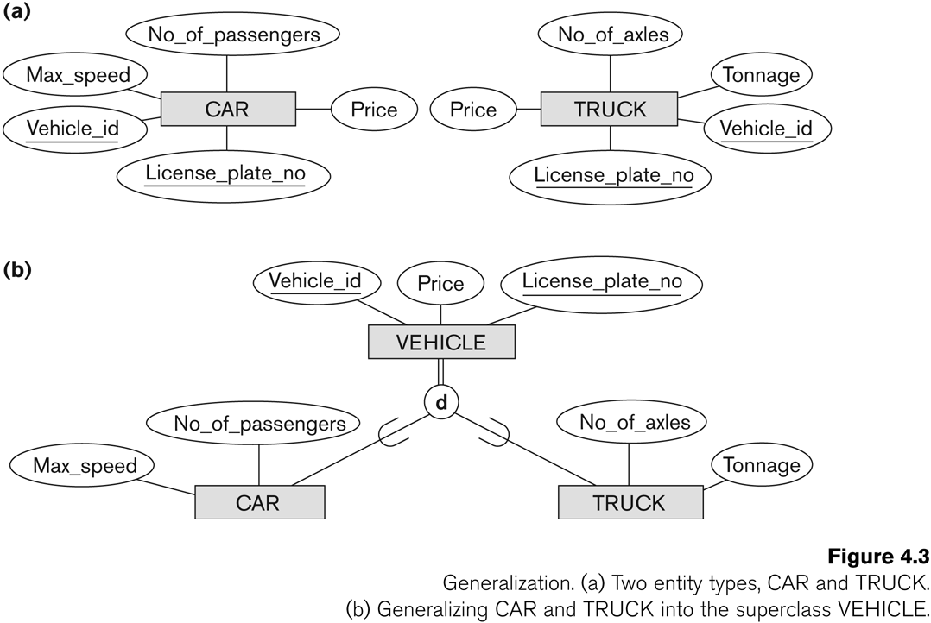
Generalization

Slide 22
Generalization
Diagrammatic notation are sometimes used to distinguish between generalization and specialization
Arrow pointing to the generalized superclass represents a generalization
Arrows pointing to the specialized subclasses represent a specialization
Do not use this notation because it is often subjective as to which process is more appropriate for a particular situation
better not to draw any arrows

Slide 23
Constraints on Specialization and Generalization (1)
If we can determine exactly those entities that will
become members of each subclass by a condition, the
subclasses are called predicate-defined (or condition-
defined) subclasses
Condition is a constraint that determines subclass
members
Display a predicate-defined subclass by writing the
predicate condition next to the line attaching the
subclass to its superclass

Slide 24
Constraints on Specialization and Generalization (2)
If all subclasses in a specialization have membership
condition on same attribute of the superclass, specialization is
called an attribute-defined specialization
Attribute is called the defining attribute of the specialization
Example: JobType is the defining attribute of the specialization {SECRETARY, TECHNICIAN, ENGINEER} of EMPLOYEE

Slide 25
Constraints on Specialization and Generalization (2)
If no condition determines membership, the subclass is called user-defined
Membership in a subclass is determined by the database users by applying an operation to add an entity to the subclass
Membership in the subclass is specified individually for each entity in the superclass by the user

Slide 26
Displaying an attribute-defined specialization in EER diagrams

Slide 27
Constraints on Specialization and Generalization (3)
Two basic constraints can apply to a specialization/generalization:
Disjointness Constraint:
Completeness Constraint:

Slide 28
Constraints on Specialization and Generalization (4)
Disjointness Constraint:
Specifies that the subclasses of the specialization
must be disjoint:
An entity can be a member of at most one of the subclasses
of the specialization
Specified by d in EER diagram
If not disjoint, specialization is overlapping:
that is the same entity may be a member of more than one
subclass of the specialization
Specified by o in EER diagram

Slide 29
Constraints on Specialization and Generalization (5)
Completeness Constraint:
Total specifies that every entity in the superclass must be a
member of some subclass in the specialization/generalization
Shown in EER diagrams by a double line
Partial allows an entity not to belong to any of the subclasses
Shown in EER diagrams by a single line

Slide 30
Constraints on Specialization and Generalization (6)
Hence, we have four types of specialization/generalization:
Disjoint, total
Disjoint, partial
Overlapping, total
Overlapping, partial
Note: Generalization usually is total because the
superclass is derived from the subclasses.

Slide 31
Example of disjoint partial Specialization

Slide 32
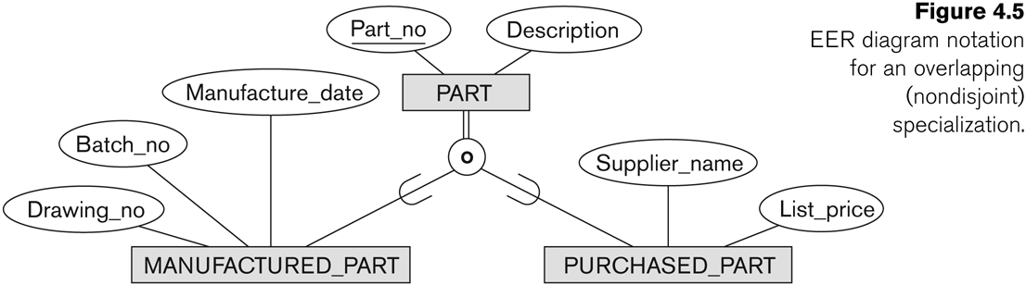
Example of overlapping total Specialization

Slide 33
Specialization/Generalization Hierarchies, Lattices & Shared Subclasses (1)
A subclass may itself have further subclasses
specified on it forms a hierarchy or a lattice
Hierarchy has a constraint that every subclass has only one
superclass (called single inheritance); this is basically a tree
structure
In a lattice, a subclass can be subclass of more than one
superclass (called multiple inheritance)

Slide 34
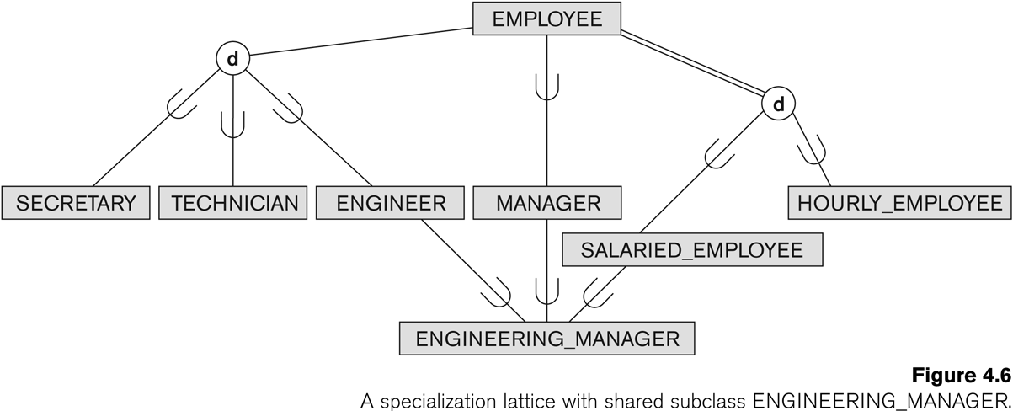
Shared Subclass “Engineering_Manager”

Slide 35
Specialization/Generalization Hierarchies, Lattices & Shared Subclasses (2)
In a lattice or hierarchy, a subclass inherits attributes not
only of its direct superclass, but also of all its
predecessor superclasses
A subclass with more than one superclass is called a shared
subclass (multiple inheritance)
Can have:
specialization hierarchies or lattices, or
generalization hierarchies or lattices,depending on
how they were derived
We just use specialization

Slide 36
Specialization/Generalization Hierarchies, Lattices & Shared Subclasses (3)
In specialization, start with an entity type and then
define subclasses of the entity type by successive
specialization called a top down conceptual
refinement process
In generalization, start with many entity types and
generalize those that have common properties
Called a bottom up conceptual synthesis process
In practice, a combination of both processes is usually
employed

Slide 37
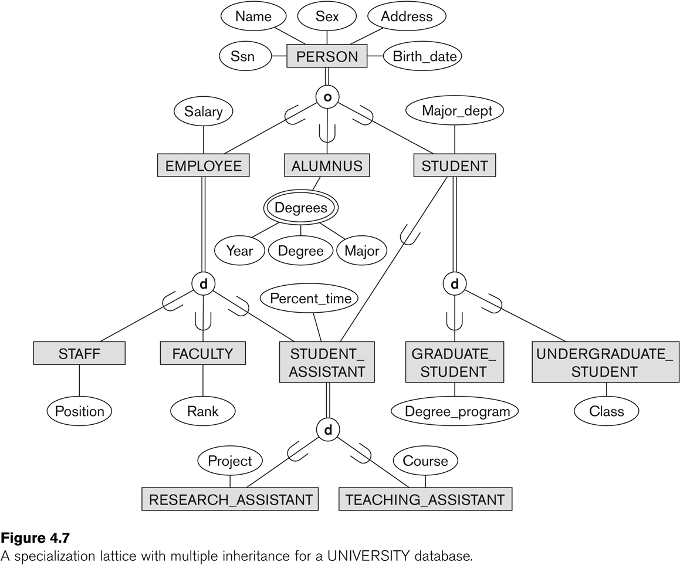
Specialization / Generalization Lattice Example (UNIVERSITY)

Slide 38
Categories (UNION TYPES)
All of the superclass/subclass relationships seen thus far have a single superclass
A shared subclass is a subclass in more than one distinct superclass/subclass relationships each relationships has a single superclass
shared subclass leads to multiple inheritance
In some cases, we need to model a single superclass/subclass relationship with more than one superclass
Superclasses can represent different entity types
Such a subclass is called a category or UNION TYPE

Slide 39
Categories /Union Type
Example: In a database for vehicle registration, a vehicle owner can be a PERSON, a BANK (holding a lien on a vehicle) or a COMPANY.
A category (UNION type) called OWNER is created to represent a subset of the union of the three superclasses COMPANY, BANK, and PERSON
A category member must exist in at least one of its superclasses
Difference from shared subclass, which is a:
subset of the intersection of its superclasses
shared subclass member must exist in all of its superclasses

Slide 40
